Slide 1

463 Project: Police Arrival Prediction
By: Sam Axler

Slide 2
Introduction and Importance
When a call is made to the police, there are a variety of factors that decide the urgency of their arrival.
This project was made both as a way to predict police arrival time for potential future cases, as well as locate and identify those important factors and processes that go into their arrival.
Understanding how the police operate is essential to understanding how they handle situations, including situations you may find yourself in the future.

Slide 3
The Categories
These are the categrories I chose to focus on when predicting Police Arrival times:
Contact Type: [Phone or Email]
Impact [The reach of the crime/incident.]
Urgency [How life-threatening the crime/incident is.]
Time of Call [00:00 to 23:59 in Military Time.]

Slide 4
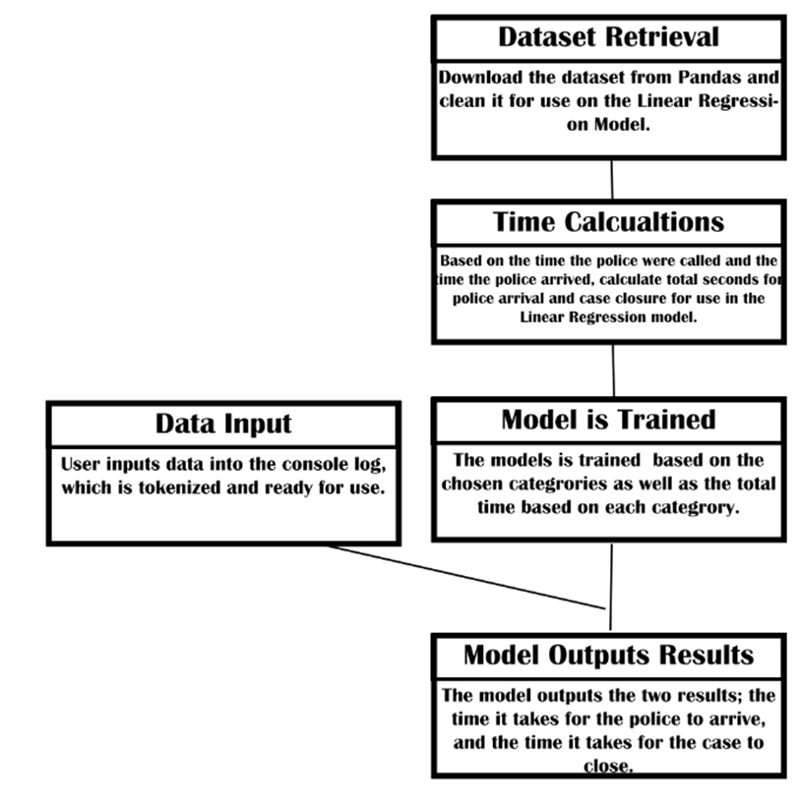
Implementation
Uses a Linear Regression model to try to predict the time it takes for police to arrive.
Time is converted from start-end dates into seconds between the two dates. This gives us a number for the regression model to predict and train off of.
The program takes inputs from the user inside the output terminal.

Slide 5
The Output
The program outputs two times: time until police arrival, and time until a case is closed.
Police intervention is not limited to arrival and arrest/medical assistance. Several days after an incident, the police will continue to look into the case, even if it was simply an accident that led to injury of self.
The second value is the estimated time it will take for the police to close the case.

Slide 6

Example:

Slide 7
Results:
Urgent Arrival:
Model Prediction: 16 Minutes, 11 Seconds
Actual, Philadelphia: 9 Minutes
Non-Urgent Arrival:
Model prediction: 38 Minutes, 12 Seconds.
Actual, Philadelphia: 15 Minutes
There is a discrepancy in the data by about 40-50%. So what happened?

Slide 8
Potential Discrepancies:
Arrival time inside Philadelphia may be different to the outskirts of Philadelphia.
Distance is not taken into account, as the distance to the police station is not apart of the dataset.
Potentially, the Linear Regression model could be over or underfit.
Most importantly, the type of crime is not included. Why?

Slide 9
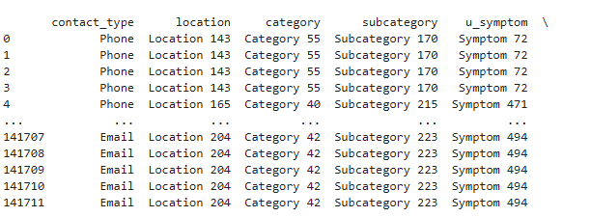
The Blocker: Police Categrories
Quite glaringly, the type of crime is also essential in estimating police arrival time. An ongoing murder would be treated as much more urgent than a potential murder, even though their scope and urgency is just as high.
The issue is the types of crimes that are stored in these datasets are listed as Categrories and Subcategrories, which vary between each police station. Moreover, these categories are not public.
I.E, Categrory 26 in Philadelphia may be different from Categrory 27 in the rest of Pennsylvania.

Slide 10
Conclusion
Police have several redacted methodologies for determining arrival timing. This makes it difficult to find a specific time without having insider information.
For a local estimator, this is as close as I can get without knowing this information.
Ultimately, I learned a lot about how the Police operate in an emergency from this project, and I hope you learned something as well.

